Slide 1
Modeling Instances
Prof. Sonia F. Panesar Department of Computer Sci. & Eng.
Babaria Institute of Technology

Slide 2
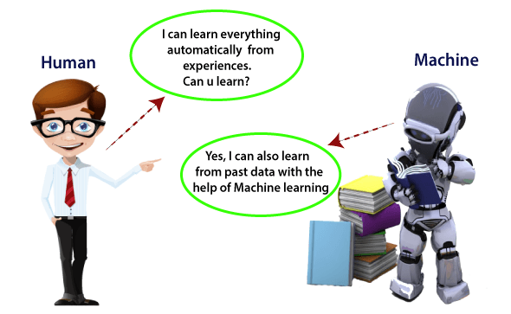
Introduction
In the real world, we are surrounded by humans who can learn everything from their experiences with their learning capability, and we have computers or machines which work on our instructions. But can a machine also learn from experiences or past data like a human does? So here comes the role of Machine Learning.

Slide 3
WHAT IS HUMAN LEARNING?
Process of gaining information through observation.
Three ways –
either somebody who is an expert in the subject directly teaches us,
(2) we build our own notion indirectly based on what we have learnt from the expert in the past, or
(3) we do it ourselves

Slide 4
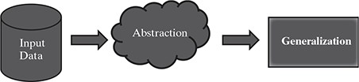
WHAT IS MACHINE LEARNING?
‘A computer program is said to learn from experience E with respect to some class of tasks T and performance measure P, if its performance at tasks in T, as measured by P, improves with experience E.’
Process of machine learning :

Slide 5
How do machines learn?
The basic machine learning process can be divided into three parts.
Data Input: Past data or information is utilized as a basis for future decision-making
Abstraction: The input data is represented in a broader way through the underlying algorithm
Generalization: The abstracted representation is generalized to form a framework for making decisions

Slide 6
TYPES OF MACHINE LEARNING
Supervised learning – Also called predictive learning. A machine predicts the class of unknown objects based on prior class-related information of similar objects.
Unsupervised learning – Also called descriptive learning. A machine finds patterns in unknown objects by grouping similar objects together.
Reinforcement learning – A machine learns to act on its own to achieve the given goals.

Slide 7
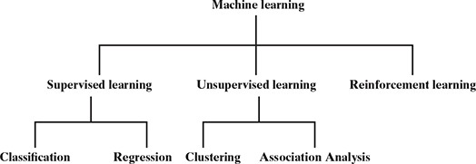
TYPES OF MACHINE LEARNING

Slide 8
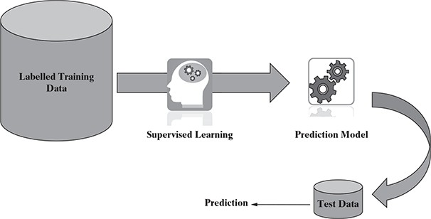
Supervised learning

Slide 9
Supervised learning
Some examples of supervised learning are :
Predicting the results of a game
Predicting whether a tumour is malignant or benign Predicting the price of domains like real estate, stocks, etc.
Classifying texts such as classifying a set of emails as spam or non-spam

Slide 10
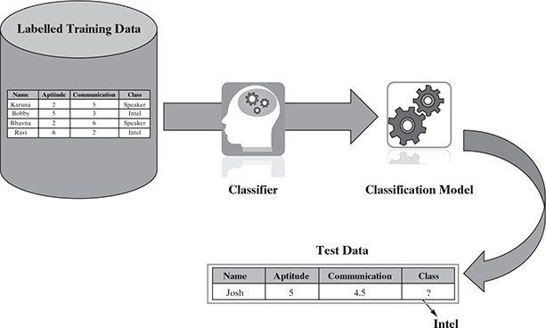
Classification

Slide 11
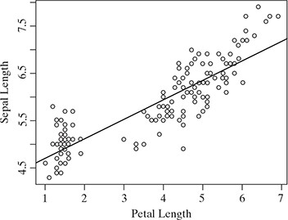
Regression
Some typical classification problems include:
Image classification Prediction of disease Win–loss prediction of game
Prediction of natural calamity like earthquake, flood, etc. Recognition of handwriting

Slide 12
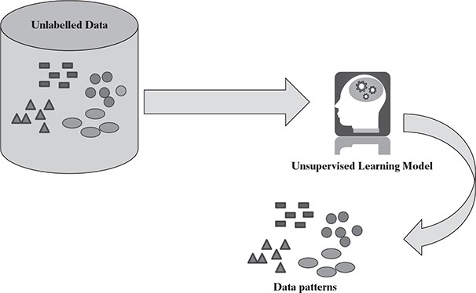
Unsupervised learning

Slide 13
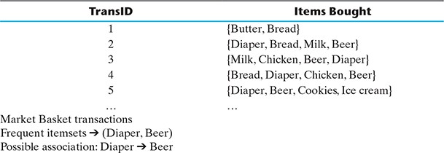
Market basket analysis

Slide 14
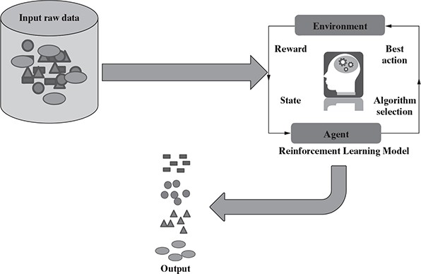
Reinforcement learning

Slide 15
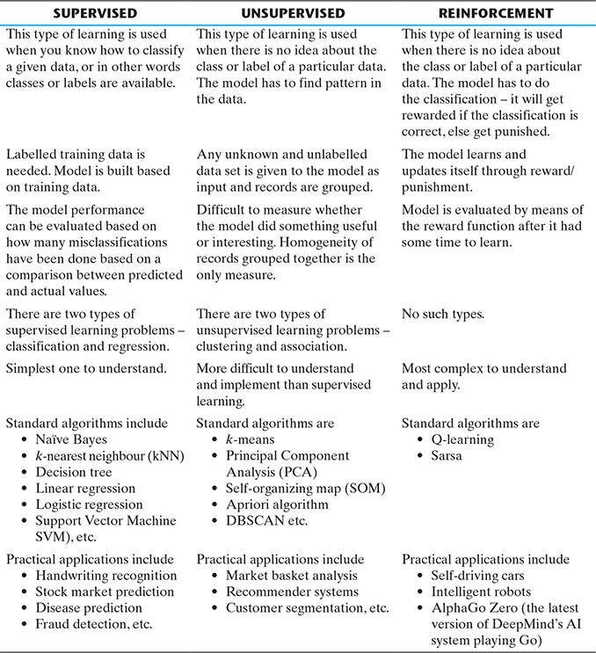
Comparison – supervised, unsupervised, and reinforcement learning

Slide 16
APPLICATIONS OF MACHINE LEARNING
Banking and finance
Insurance
Healthcare

Slide 17
STATE-OF-THE-ART LANGUAGES/TOOLS IN MACHINE LEARNING
Python
R
Matlab
SAS

Slide 18
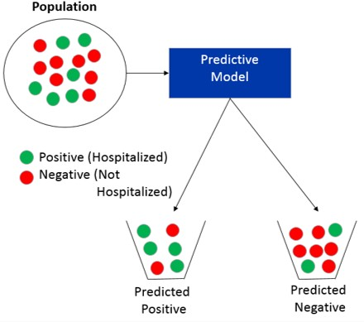
Classification

Slide 19
Classification Algorithm
Classification is a form of supervised machine learning
The classification algorithm learns from labeled data. It is used to identify the category of new observations on the basis of training data. In Classification, a program learns from the given dataset or observations and then classifies new observation into a number of classes or groups. Such as, Yes or No, 0 or 1, Spam or Not Spam, cat or dog, etc. Classes can be called as targets/labels or categories.
Unlike regression, the output variable of Classification is a category, not a value, such as "Green or Blue", "fruit or animal", etc. Since the Classification algorithm is a Supervised learning technique, hence it takes labeled input data, which means it contains input with the corresponding output.
y=f(x), where y = categorical output

Slide 20
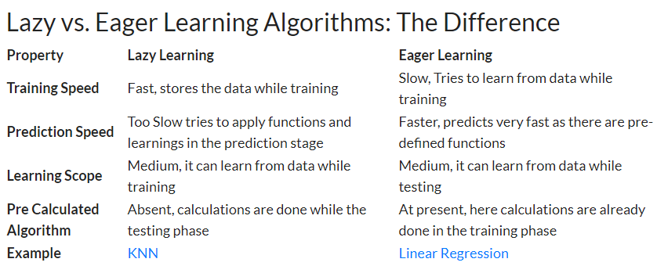

Slide 21
Clustering Vs Classification
Paramenter | CLASSIFICATION | CLUSTERING
Type | used for supervised learning | used for unsupervised learning
Basic | process of classifying the input instances based on their corresponding class labels | grouping the instances based on their similarity without the help of class labels
Need | it has labels so there is need of training and testing dataset for verifying the model created | there is no need of training and testing dataset
Complexity | more complex as compared to clustering | less complex as compared to classification
Example Algorithms | Logistic regression, Naive Bayes classifier, Support vector machines etc. | k-means clustering algorithm, Fuzzy c-means clustering algorithm, Gaussian (EM) clustering algorithm etc.

Slide 22
Nearest Neighbour Analysis
Nearest Neighbour Analysis measures the spread or distribution of something over a geographical space.
It provides a numerical value that describes the extent to which a set of points are clustered or uniformly spaced.
Nearest neighbor methods work by taking an observation’s attribute value and then locating another observation whose attribute value is numerically nearest to it

Slide 23
Classifying Data with Average Nearest Neighbor Algorithms
Average nearest neighbor algorithms are basic yet powerful classification algorithms. They’re useful for finding and classifying observations that are most similar on average.
Average nearest neighbor algorithms are used in pattern recognition, in chemical and biological structural analysis, and in spatial data
modeling.
They’re most often used in biology, chemistry, engineering, and geosciences.

Slide 24
The purpose of using an average nearest neighbor algorithm is to classify observations based on the average of the arithmetic distances between them.
If your goal is to identify and group observations by average similarity, the average nearest neighbor algorithm is a useful way to do that.
With respect to nearest neighbor classifiers, a dataset is composed of observations, each of which has an x- and y-variable.
An x-variable represents the input value, or feature, and the y-variable represents the data label, or target variable.

Slide 25
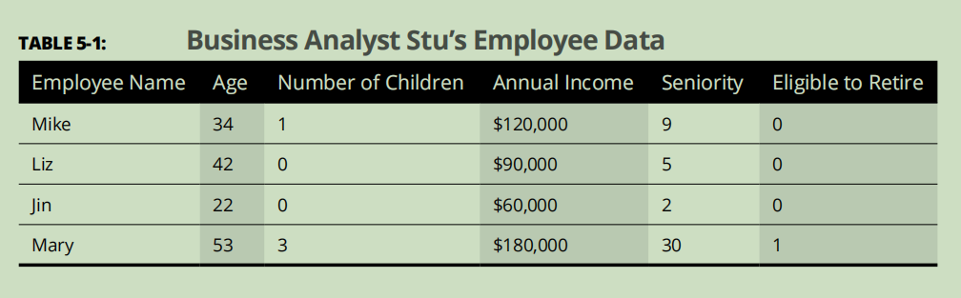
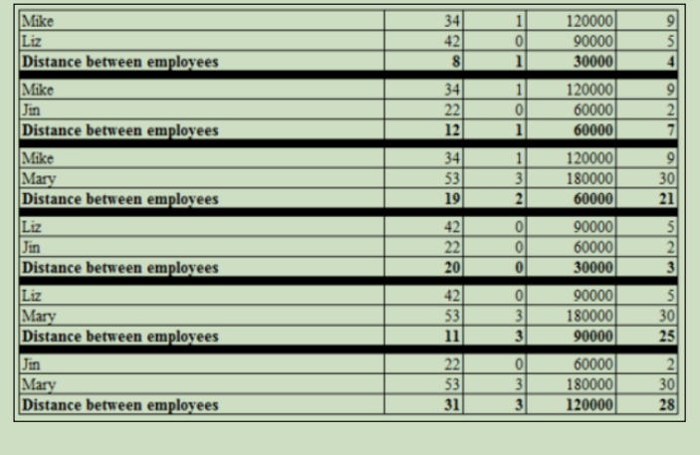

Slide 26
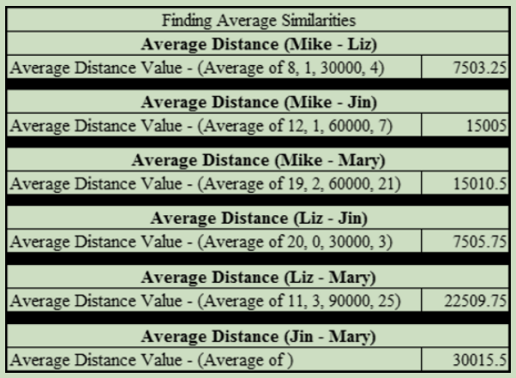

Slide 27
Now groups the employees by the average separation distance between them. Because the average separation distance values between Mike, Liz, and Jin are the smallest, they’re grouped into class 0.
Mary’s average separation distances are
quite unlike the others, so she is put into her own class — Class 1.
 | average separation distance(min) | class label
mike | 7503 with liz | 0
liz | 7503 & 7505 with mike and jin | 0
jin | 7505 with liz | 0
mary | 15010.5 with mike but too far from liz and jin | 1

Slide 28
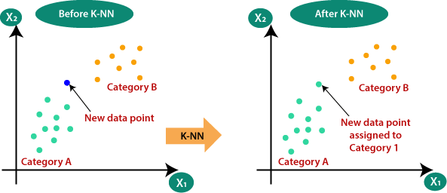
K Nearest Neighbour Analysis

Slide 29
KNN Algorithm
K-Nearest Neighbour is one of the simplest Machine Learning algorithms based on Supervised Learning technique.
K-NN algorithm assumes the similarity between the new case/data and available cases and put the new case into the category that is most similar to the available categories.
K-NN algorithm stores all the available data and classifies a new data point based on the similarity. This means when new data appears then it can be easily classified into a well suite category by using K- NN algorithm.
K-NN algorithm can be used for Regression as well as for Classification but mostly it is used for the Classification problems.
K-NN is a non-parametric algorithm, which means it does not make any assumption on underlying data.
It is also called a lazy learner algorithm because it does not learn from the training set immediately instead it stores the dataset and at the time of classification, it performs an action on the dataset.
KNN algorithm at the training phase just stores the dataset and when it gets new data, then it classifies that data into a category that is much similar to the new data.
Example: Suppose, we have an image of a creature that looks similar to cat and dog, but we want to know either it is a cat or dog. So for this identification, we can use the KNN algorithm, as it works on a similarity measure. Our KNN model will find the similar features of the new data set to the cats and dogs images and based on the most similar features it will put it in either cat or dog category.

Slide 30
How it works?
Step-1: Select the number K of the neighbors
Step-2: Calculate the Euclidean distance of K number of neighbors
Step-3: Take the K nearest neighbors as per the calculated Euclidean distance.
Step-4: Among these k neighbors, count the number of the data points in each category.
Step-5: Assign the new data points to that category for which the number of the neighbor is maximum.
Step-6: Our model is ready.

Slide 31
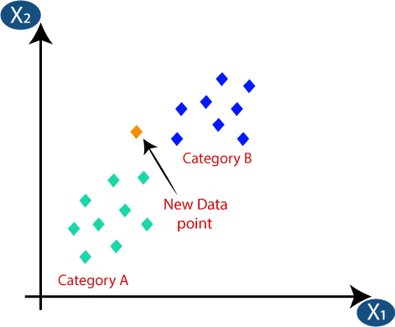
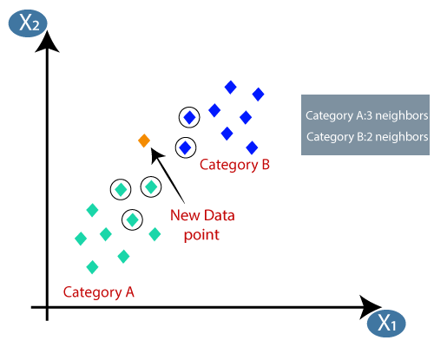
How it Works

Slide 32
Usefulness & Limitation
Useful for multi-label learning — supervised learning
It takes a lot longer than other classification methods to classify a sample
performance depends on function and on the neighborhood parameter k.
the value
distance of the

Slide 33
Applications
website categorization, web page ranking
customer relationship management (CRM)

Slide 34
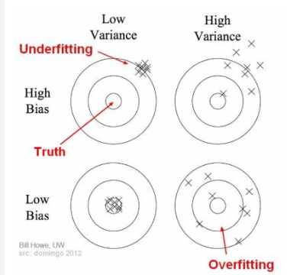

Slide 35
Simple Linear Regression
Simple Linear Regression is a type of Regression algorithms that models the relationship between a dependent variable and a single independent variable.
The relationship shown by a Simple Linear Regression model is linear or a sloped straight line, hence it is called Simple Linear Regression.
The key point in Simple Linear Regression is that the dependent variable must be a continuous/real value. However, the independent variable can be measured on continuous or categorical values.

Slide 36
Simple Linear regression algorithm has mainly two objectives:
Model the relationship between the two variables. Such as the relationship between Income and expenditure, experience and Salary, etc.
Forecasting new observations. Such as Weather forecasting according to temperature, Revenue of a company according to the investments in a year, etc.

Slide 37
Simple Linear Regression Model:
The Simple Linear Regression model can be represented using the below equation:
y= a0+a1x+ ε
Where,
a0= It is the intercept of the Regression line (can be obtained putting x=0)
a1= It is the slope of the regression line, which tells whether the line is increasing or decreasing.
ε = The error term. (For a good model it will be negligible)
Notes:
https://www.javatpoint.com/simple-linear-regression-in-machine-learning

Slide 38
Multiple Linear Regression MLR
Multiple Linear Regression is an extension of Simple Linear regression as it takes more than one predictor variable to predict the response variable. It can be defined as:
Multiple Linear Regression is one of the important regression algorithms which models the linear relationship between a single dependent continuous variable and more than one independent variable.

Slide 39
Keypoints for MLR
For MLR, the dependent or target variable(Y) must be the continuous/real, but the predictor or independent variable may be of continuous or categorical form.
Each feature variable must model the linear relationship with the dependent variable.
MLR tries to fit a regression line through a multidimensional space of data-points.

Slide 40

MLR Equation
In Multiple Linear Regression, the target variable(Y) is a linear combination of multiple predictor variables x1, x2, x3, ...,xn. Since it is an enhancement of Simple Linear Regression, so the same is applied for the multiple linear regression equation, the equation becomes:
Where,
Y= Output/Response variable
b0, b1, b2, b3 , bn....= Coefficients of the model.
x1, x2, x3, x4,...= Various Independent/feature variable

Slide 41
Assumptions of Linear Regression
Linear relationship between the features and target
Small or no multicollinearity between the features:

Slide 42
Assumptions for Multiple Linear Regression:
A linear relationship should exist between the Target and predictor variables.
The regression residuals must be normally distributed.
MLR assumes little or no multicollinearity (correlation between the independent variable) in data.
Notes:
https://www.javatpoint.com/multiple-linear-regression-in-machine-learning

Slide 43
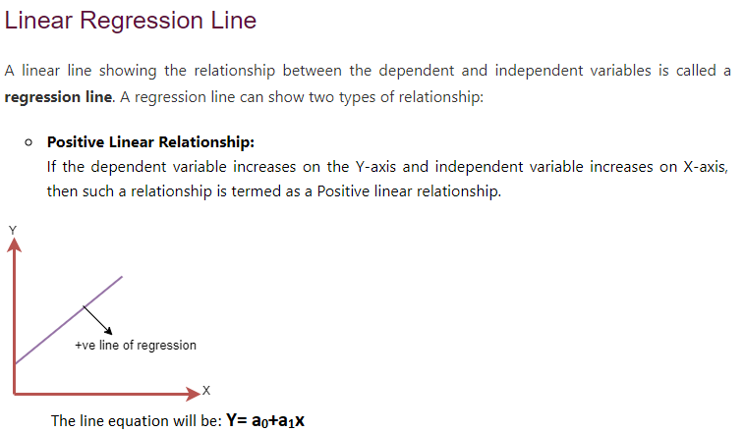

Slide 44
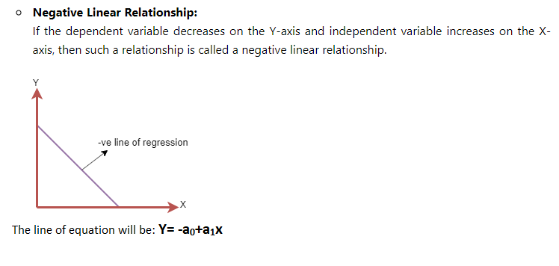

Slide 45
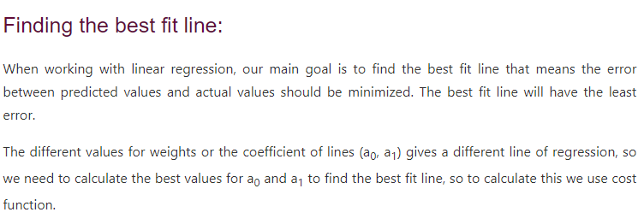

Slide 46
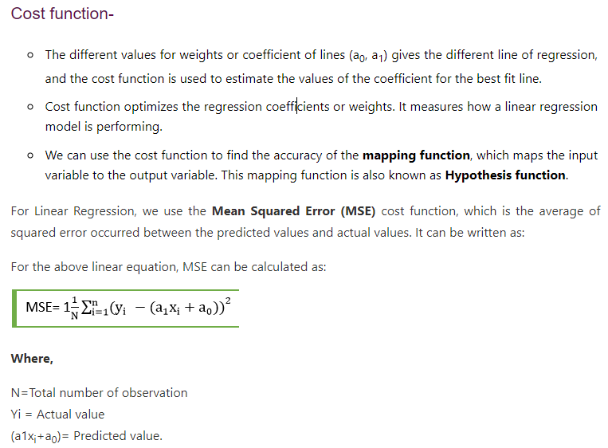

Slide 47
Logistic Regression
Logistic regression is one of the most popular Machine Learning algorithms, which comes under the Supervised Learning technique. It is used for predicting the categorical dependent variable using a given set of independent variables.
Logistic regression predicts the output of a categorical dependent variable. Therefore the outcome must be a categorical or discrete value. It can be either Yes or No, 0 or 1, true or False, etc. but instead of giving the exact value as 0 and 1, it gives the probabilistic values which lie between 0 and 1.
Logistic Regression is much similar to the Linear Regression except that how they are used. Linear Regression is used for solving Regression problems, whereas Logistic regression is used for solving the classification problems.

Slide 48
In Logistic regression, instead of fitting a regression line, we fit an "S" shaped logistic function, which predicts two maximum values (0 or 1).
The curve from the logistic function indicates the likelihood of something such as whether the cells are cancerous or not, a mouse is obese or not based on its weight, etc.
Logistic Regression is a significant machine learning algorithm because it has the ability to provide probabilities and classify new data using continuous and discrete datasets.
Logistic Regression can be used to classify the observations using different types of data and can easily determine the most effective variables used for the classification. The below image is showing the logistic function:

Slide 49
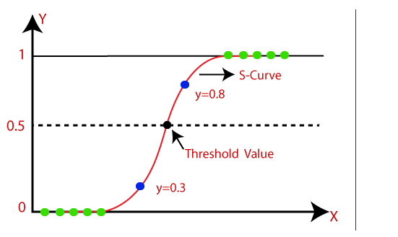

Slide 50
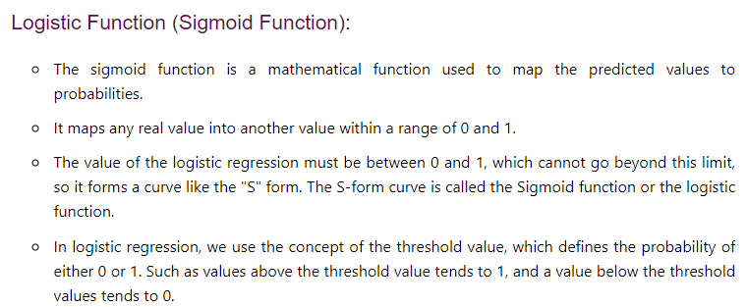

Slide 51
Assumptions for Logistic Regression: The dependent variable must be categorical in nature. The independent variable should not have multi-collinearity.

Slide 52
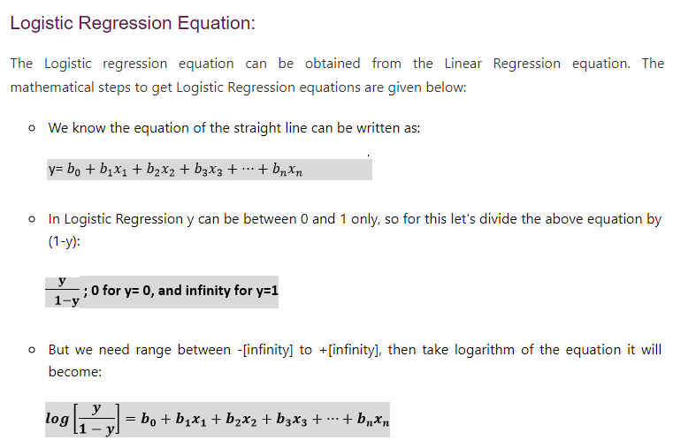

Slide 53
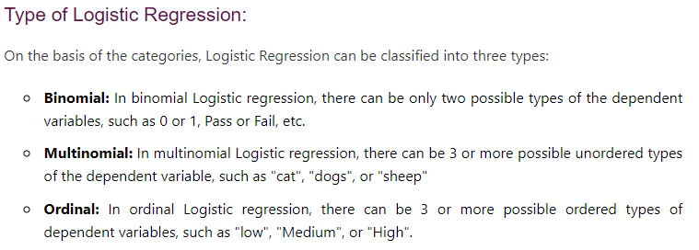

Slide 54
Model Assessment/Evaluation
Machine Learning Model does not require hard-coded algorithms. We feed a large amount of data to the model and the model tries to figure out the features on its own to make future predictions.
So we must also use some techniques to determine the predictive power of the model.
Model evaluation is the process that uses some metrics which help us to analyze the performance of the model.
model development is a multi-step process and a check should be kept on how well the model generalizes future predictions. Therefore evaluating a model plays a vital role so that we can judge the performance of our model.
There are many metrics like Accuracy, Precision, Recall, F1 score, Area under Curve, Confusion Matrix, and Mean Square Error.

Slide 55
Cross Validation
Cross Validation is a method in which we do not use the whole dataset for training.
In this technique, some part of the dataset is reserved for testing the model. There are many types of Cross-Validation out of which K Fold Cross Validation is mostly used.
In K Fold Cross Validation the original dataset is divided into k subsets. The subsets are known as folds. This is repeated k times where 1 fold is used for testing purposes. Rest k-1 folds are used for training the model.
So each data point acts as a test subject for the model as well as acts as the training subject. It is seen that this technique generalizes the model well and reduces the error rate

Slide 56
Holdout
Holdout is the simplest approach. It is used in neural networks as well as in many classifiers. In this technique, the dataset is divided into train and test datasets. The dataset is usually divided into ratios like 70:30 or 80:20.
Normally a large percentage of data is used for training the model and a small portion of the dataset is used for testing the model.

Slide 57
To evaluate the performance or quality of the model, different metrics are used, and these metrics are known as performance metrics or evaluation metrics. Each task or problem is divided into classification and Regression. Not all metrics can be used for all types of problems; hence, it is important to know and understand which metrics should be used. Different evaluation metrics are used for both Regression and Classification tasks.

Slide 58
Performance Metrics for Classification
Accuracy
Confusion Matrix
Precision
Recall
F-Score
Notes:
https://www.javatpoint.com/performance-metrics-in-machine-learning

Slide 59
II. Confusion Matrix
A confusion matrix is a tabular representation of prediction outcomes of any binary classifier, which is used to describe the performance of the classification model on a set of test data when true values are known.
The confusion matrix is simple to implement, but the terminologies used in this matrix might be confusing for beginners.
A typical confusion matrix for a binary classifier looks like the below image(However, it can be extended to use for classifiers with more than two classes).

Slide 60
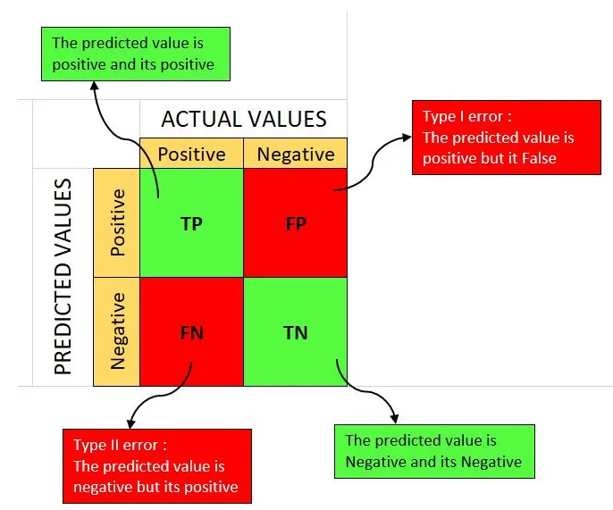

Slide 61
True Positives (TP): when the actual value is Positive and predicted is also Positive.
True negatives (TN): when the actual value is Negative and prediction is also Negative.
False positives (FP): When the actual is negative but prediction is Positive. Also known as the Type 1 error
False negatives (FN): When the actual is Positive but the prediction is Negative. Also known as the Type 2 error

Slide 62
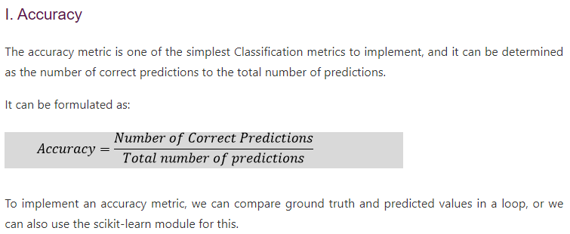

Slide 63
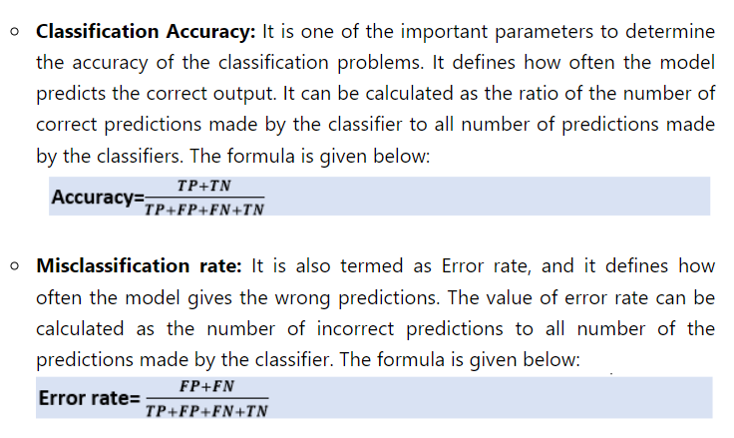

Slide 64
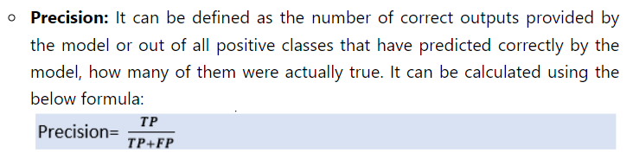

Slide 65
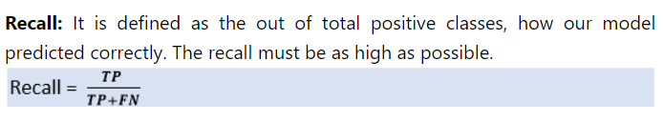
Recall or Sensitivity

Slide 66
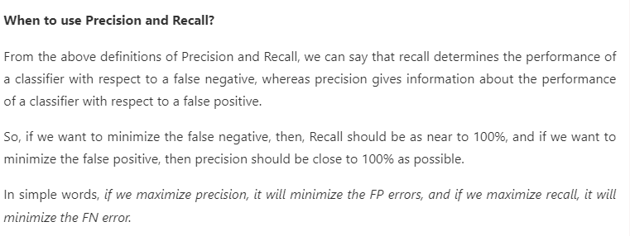

Slide 67
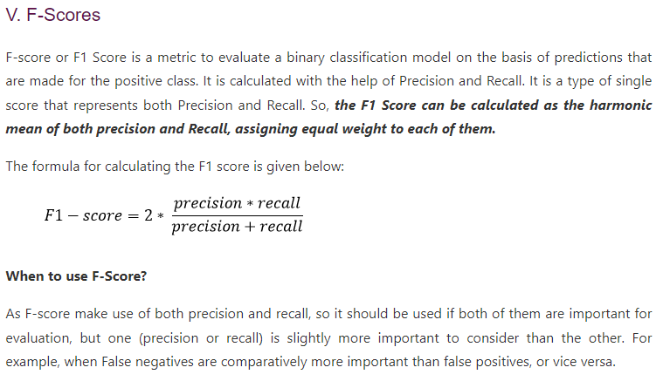

Slide 68
Performance Metrics for Regression
Regression is a supervised learning technique that aims to find the relationships between the dependent and independent variables. A predictive regression model predicts a numeric or discrete value. The metrics used for regression are different from the classification metrics. It means we cannot use the Accuracy metric (explained above) to evaluate a regression model; instead, the performance of a Regression model is reported as errors in the prediction. Following are the popular metrics that are used to evaluate the performance of Regression models.
Mean Absolute Error
Mean Squared Error
R2 Score

Slide 69
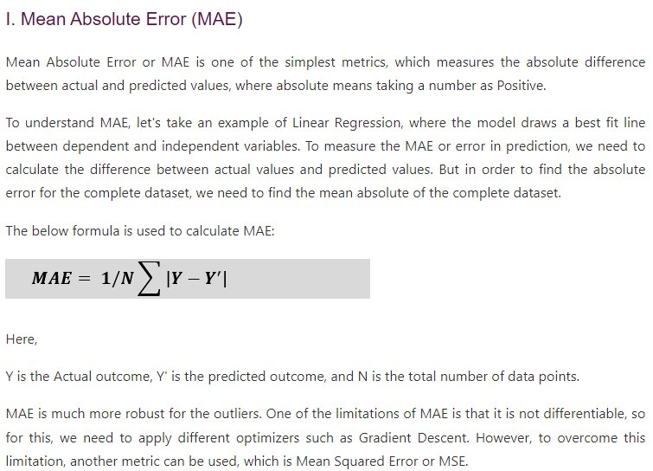

Slide 70
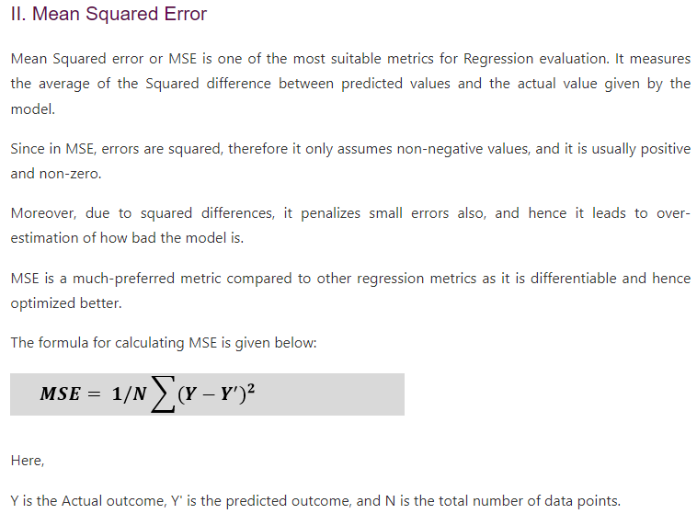

Slide 71
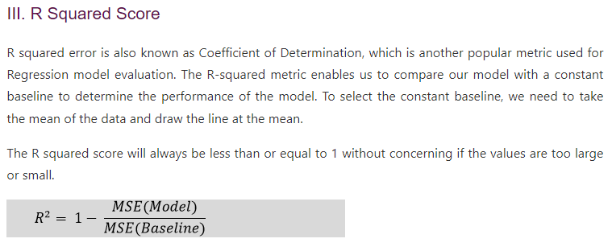

Slide 72
Feature Selection
It is a process of automatically or manually selecting the subset of most appropriate and relevant features to be used in model building.
Feature selection is performed by either including the important features or excluding the irrelevant features in the dataset without changing them.

Slide 73
Benefits of Feature Selection
It helps in avoiding the curse of dimensionality.
It helps in the simplification of the model so that it can be easily interpreted by the researchers.
It reduces the training time.
It reduces overfitting hence enhance the generalization.

